Slide 1

Note: The data and information in this document is reflective of a hypothetical situation and client. This document is to be used for KPMG Virtual Internship purposes only.
Sprocket Central Pty Ltd
Data analytics approach
Firdaws Yahya

Slide 2
Note: The data and information in this document is reflective of a hypothetical situation and client. This document is to be used for KPMG Virtual Internship purposes only.
Agenda
Introduction
Data Exploration
Model Development
Interpretation

Slide 3
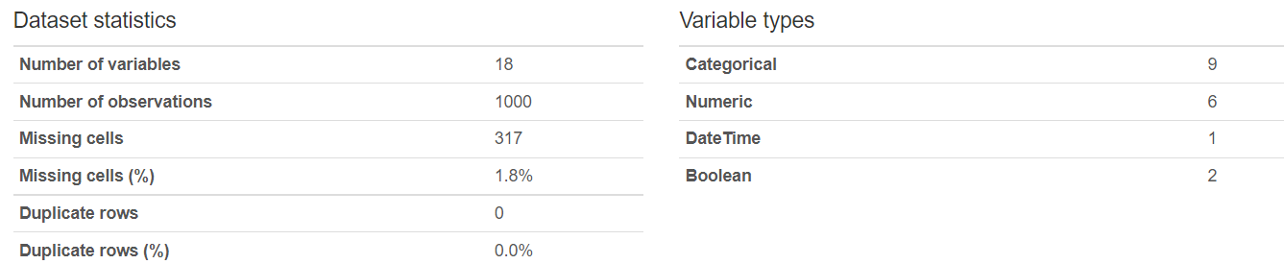
Note: The data and information in this document is reflective of a hypothetical situation and client. This document is to be used for KPMG Virtual Internship purposes only.
Introduction
The following changes were made to the data
Missing values were imputed with either the mean or assigned new values like Not stated or not known. For job industry, this amounted to 159 customers
Deceased customers were dropped
Age column was added to the data
Customer Ids was given starting with 4001
No duplicates found
Values like gender were renamed

Slide 4
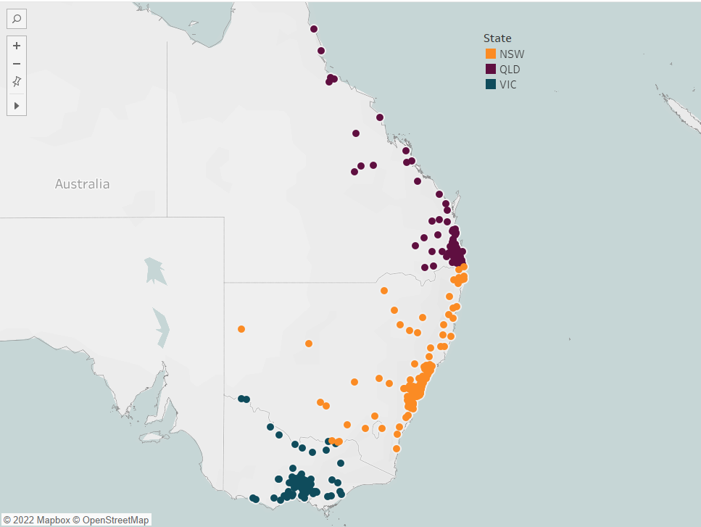
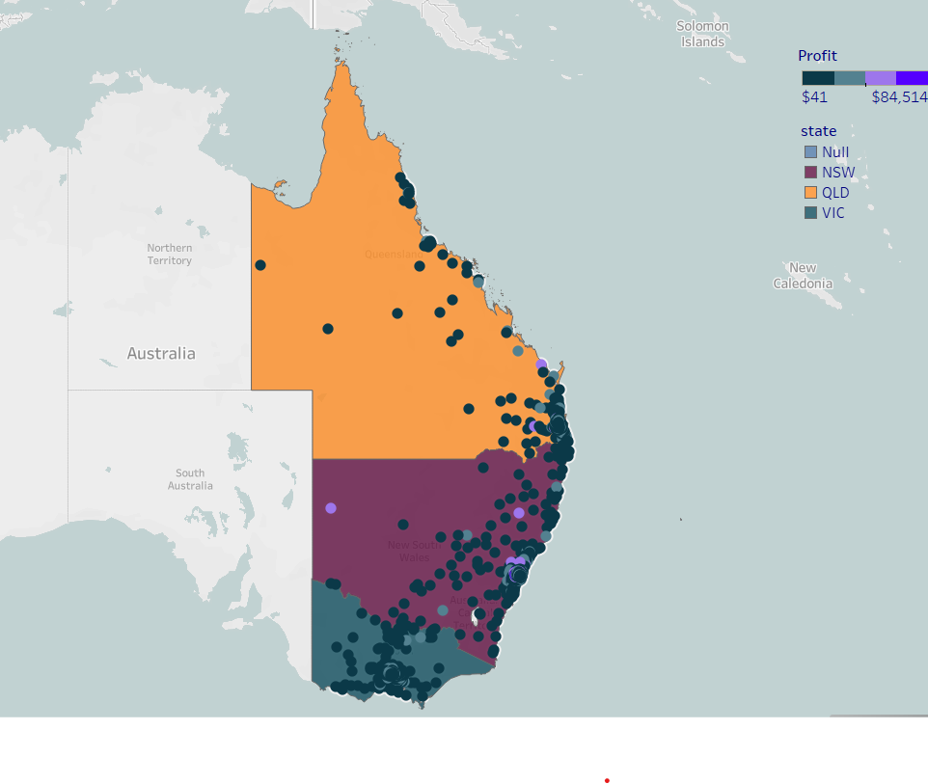
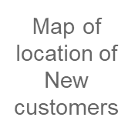
Note: The data and information in this document is reflective of a hypothetical situation and client. This document is to be used for KPMG Virtual Internship purposes only.
Data Exploration:Location
50.6% of new customers live in New South Wales(NSW)
Customers clustered in particular part of each states. This cluster also reflects in that of old customers.
New South Wales houses the most customers
Based on location, NSW has the highest number of bike related purchases in the past three years with a count of 25,409. This gives it a difference of over 50% from the other two location.

Slide 5
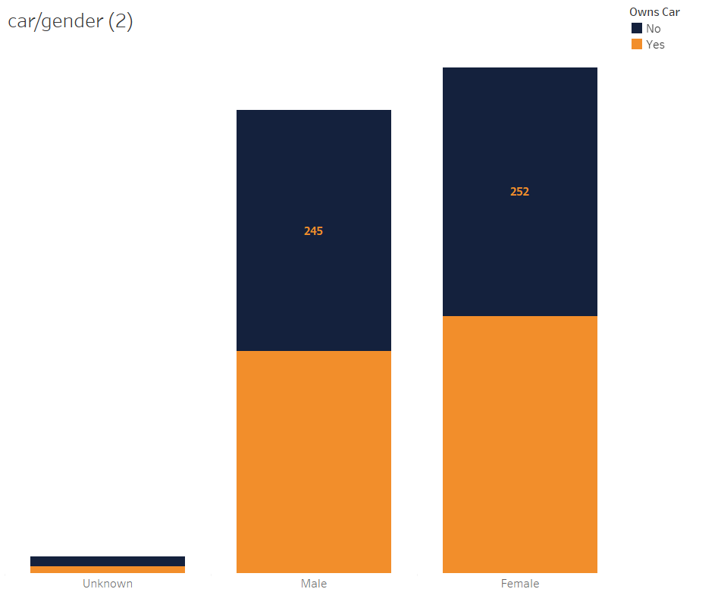
Note: The data and information in this document is reflective of a hypothetical situation and client. This document is to be used for KPMG Virtual Internship purposes only.
Data Exploration:CAR OWNERS
There is a 2.70% difference between customers who own cars and those who does not
50.7% of customers do not own cars
261 females own car compared to 255 males and 7 of unknown genders
In NSW customers who do not own cars exceed those who own cars by 13.9%
In QLD and VIC, car owners are the majority
Based on past data , car owners brought in the highest profit compared to the 3.9% difference of those who do not own a vehicle.

Slide 6
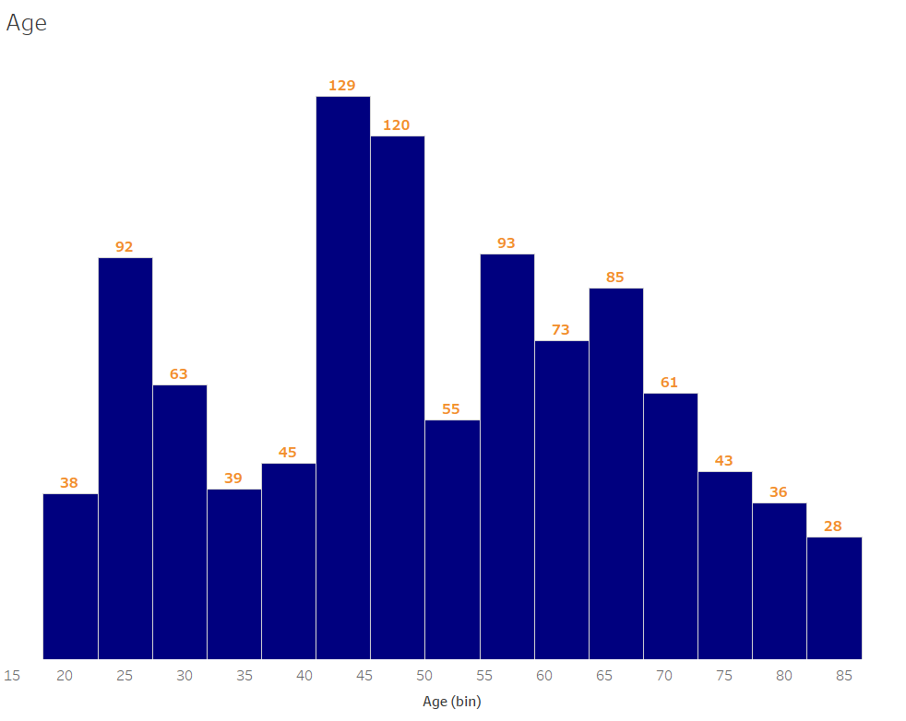
Note: The data and information in this document is reflective of a hypothetical situation and client. This document is to be used for KPMG Virtual Internship purposes only.
Data Exploration:Age
Customers between age 40-50 are the majority with the average being 44
Those between age 41-49 consist majorly of females
In NSW and VIC 41-49 are the majority
In QLD ages 46-55 are the majority
Focus ages:
41-49
56-59
23-25

Slide 7
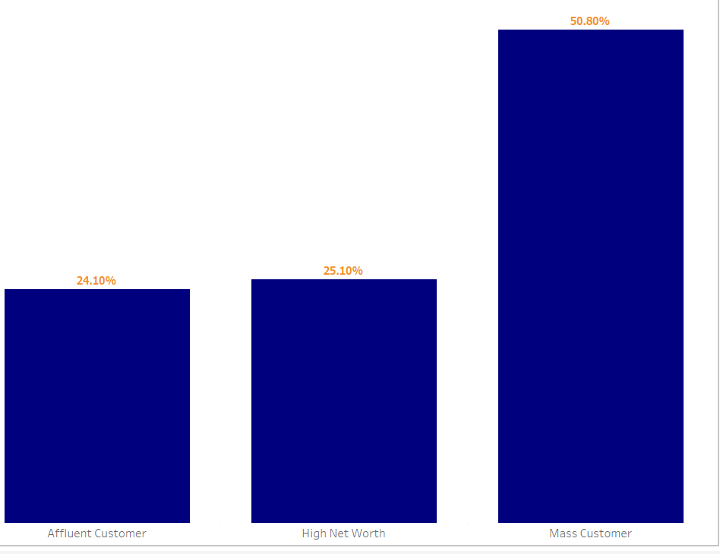
Note: The data and information in this document is reflective of a hypothetical situation and client. This document is to be used for KPMG Virtual Internship purposes only.
Data Exploration:Wealth Segment
Over half of customers are classified as mass customers
Most of the customers are mass customers
In past data Mass customers brought in the most profit
NSW has the highest customers in all segment
Females are also the majority customers under mass customer and High net worth
Male lead in number under the affluent customer segment

Slide 8
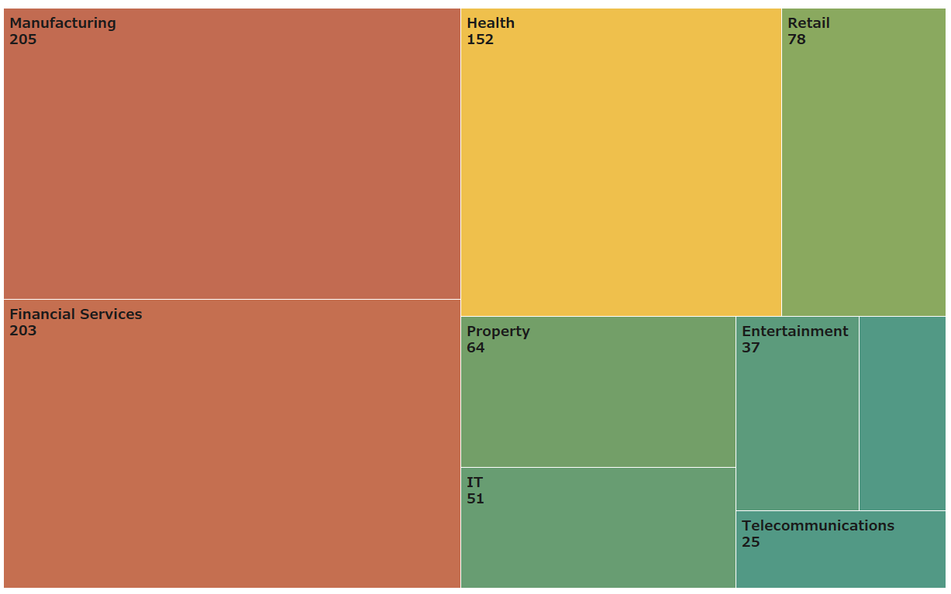
Note: The data and information in this document is reflective of a hypothetical situation and client. This document is to be used for KPMG Virtual Internship purposes only.
Data Exploration:Job Industry
Manufacturing and financial services are the leading industry
There are more females in the Financial service industry and more males in the manufacturing industry

Slide 9
Note: The data and information in this document is reflective of a hypothetical situation and client. This document is to be used for KPMG Virtual Internship purposes only.
Model Development
CUSTOMER LIFETIME VALUE
The lifetime value of each customer is created. A benchmark can be assigned and those who asses those benchmark can then be targeted.
CLV=Average value of sale*Number of transactions*Retention time period
Customer Segmentation based on:
Customer Lifetime Value(CLV)
RFM Analysis
Customers can be targeted based on demographics given in the next slide or based on their RFM score or customer lifetime value
RFM
Focus is on those who purchase frequently, has bought from the store recently and also contributed the most monetary wise.
Those with Higher RFM scores are segmented then targeted

Slide 10
Note: The data and information in this document is reflective of a hypothetical situation and client. This document is to be used for KPMG Virtual Internship purposes only.
Interpretation
Here is a summary
Target customers are of the following:
Between age 41-49 and 22-25
Females
Residents in New South Wales area
Belong to mass customers wealth segment
Work in either the manufacturing or financial industry

Slide 11
Note: The data and information in this document is reflective of a hypothetical situation and client. This document is to be used for KPMG Virtual Internship purposes only.
Appendix

Slide 12
Note: The data and information in this document is reflective of a hypothetical situation and client. This document is to be used for KPMG Virtual Internship purposes only.
Appendix
This is an optional slide where you may place any supporting items.

